Slide 1
PRINCIPLES OF ECONOMICS
Salimah Musharrif
FPEC 101 – LECTURE 6 Unit 2

Slide 2
PRINCIPLES OF ECONOMICS
Production Costs and Market Structures
FPEC 101 – LECTURE 6 Unit 2

Slide 3
Lecture Outline
Economic, Short and Long Run costs
Economic Costs
Short Run and Long run Costs

Slide 4
Economic Costs
Explicit costs - monetary payments or cash expenditures made for labor, materials, fuel, transportation services, payments for use of resources owned by others.
Implicit costs are the opportunity costs of using self-owned, self-employed resources, money payments that self-employed resources could have earned in their best alternative use

Slide 5
Economic Costs
Consider the following data:
A person earns $22,000.
He decides to set up his own business.
He invests $20,000 of his savings
The savings earned $1,000 annually
The person uses their own building for which they could earn $5,000
Staff is hired at the cost of $18,000
The person would earn $5,000 as an entrepreneur in any other venture

Slide 6
Total sales revenue $120,000
Cost of material $40,000 Labor salary $18,000 Utilities $5000
Total (explicit) costs $63,000 Accounting profit 57,000
Accounting Profit = Sales Revenue – Explicit costs

Slide 7
Accounting profit $57,000
Foregone interest $1,000 Foregone rent $5,000 Foregone wages $22,000
Foregone Entreprenuerial income $5,000
Total (implicit) costs $33,000 Economic profit $24,000
Economic Profit = Sales Revenue – Economic Costs
Economic Profit = Sales revenue – Implicit Costs + Explicit Costs

Slide 8
Normal profit and Economic profit
The $5000 implicit cost of the entrepreneurial talent is a normal profit.
Just like the forgone rent and wages, the payment that could be received for performing the functions of an entrepreneur is indeed an implicit cost. These are the payments necessary to retain a factor of production in the current endeavor. So a normal profit is a cost of doing business.
Economic profit or Pure profit thus is total revenue less economic costs (explicit and implicit costs, the latter including a normal profit to the entrepreneur).
Economic profit = total revenue - economic cost

Slide 9
Short Run
Fixed Plant . It is a period where there is at least one fixed factor which may be the plant (firm) or production unit. Production can be changed only by variable factors. The short run is a period too brief for a firm to alter its plant capacity, yet long enough to permit a change in the degree to which the fixed plant is used. The firm’s plant capacity is fixed in the short run. However, the firm can vary its output by applying larger or smaller amounts of labor, materials, and other resources to that plant. It can use its existing plant capacity more or less intensively in the short run.
Thus too short to change plant capacity but long enough to use fixed plant more or less intensively. In the short run, our farmer’s plant (land and farm machinery) is fixed. But he does have time in the short run to cultivate tomatoes more intensively by applying more labor and more fertilizer and pesticides to the crop.

Slide 10
Long Run
This is that period of time when the production process is being started or extended and every cost becomes a variable cost. Production can be increased by increasing any factor of production
Time period long enough for firms to adjust their plant sizes and for new firms to enter (or existing firms to leave) the industry. In the “tomato industry,” for example, our farmer has time to acquire additional land and buy more machinery and equipment.
Variable Plant .From the viewpoint of an existing firm, the long run is a period long enough for it to adjust the quantities of all the resources that it employs, including plant capacity. From the industry’s viewpoint, the long run also includes enough time for existing firms to dissolve and leave the industry or for new firms to be created and enter the industry.

Slide 11
Short Run Production Relationships
Cost of output depends on cost of input
Cost of input depends on the supply and demand for it
In the short run, we consider relationship between input and output, specifically labor on fixed plant.

Slide 12
Short-Run Production Relationships
Total Product (TP) = total quantity produced
Marginal Product (MP) = change in total product
change in labor input
Average Product (AP) = total product
units of labor
Labor productivity or unit of output per input
In the short run, a firm can increase output for a certain time by adding units of labor to its fixed plant. We need to understand by how much will output rise when it adds the labor.
Total product refers to the total output that can be produced in a given period of time.
Average product is the total production divided by the number of workers, while
Marginal product refers to the additional amount of output produced.

Slide 13
Law of Diminishing Returns
Assuming technology is fixed and techniques of production do not change.
As successive units of a variable resource (say, labor) are added to a fixed resource (say, capital or land), beyond some point the extra, or marginal, product that can be attributed to each additional unit of the variable resource will decline.
Output will eventually rise by smaller and smaller amounts as more workers are hired.

Slide 14
Law of Diminishing Returns
Marginal output increases with increase in number of workers, reaches a maximum and then declines.
Assumed all units of labor are equally productive and have same quality.
Marginal product ultimately diminishes because more workers are being used relative to the amount of plant and equipment available.

Slide 15
Law of Diminishing Returns
Units of labour | TP | MP | AP
0 | 0
1 | 10
2 | 25
3 | 45
4 | 60
5 | 70
6 | 75
7 | 75
8 | 70
change in total product
MP=
change in labour input
Table 20.1
Mc Connell & Brue

Slide 16
Law of Diminishing Returns
Units of labour | TP | MP | AP
0 | 0
1 | 10
2 | 25
3 | 45
4 | 60
5 | 70
6 | 75
7 | 75
8 | 70
Increasing marginal returns
10
15
20
Diminishing marginal returns
15
10
5
0
Negative marginal returns
-5

Slide 17
Law of Diminishing Returns
total product
AP=
Units of labour | TP | MP | AP
0 | 0
1 | 10
2 | 25
3 | 45
4 | 60
5 | 70
6 | 75
7 | 75
8 | 70
total labour input
10
15
10.00
12.50
20
15.00
15
15.00
10
5
14.00
0
12.50
-5
10.71
8.75

Slide 18
MP rising , TP increases at an increasing rate.
MP + but falling, TP increases at decreasing rate
MP = 0, TP is max
MP negative, TP falls.
AP increasing, MP>AP
AP decreasing, MP<AP
MP = AP where AP is maximum.
TP
increasing
marginal
returns
diminishing
marginal returns
negative marginal returns
Fig 20.2
Mc Connell & Brue
AP
MP

Slide 19
Marginal and Average Values
MP
>AP
AP falling
AP
AP rising
MP
<AP
MP

Slide 20
Relationships
MP rising , TP increases at an increasing rate.
MP + but falling, TP increases at decreasing rate
MP = 0, TP is max
MP negative, TP falls.
If AP increasing, MP>AP
When AP decreasing, MP<AP
MP = AP where AP is maximum.

Slide 21
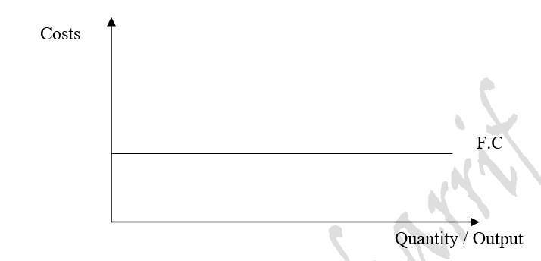
Short Run Costs-
Fixed, Variable and Total Cost
Fixed Cost
A feature of the short run only, fixed costs are the indirect costs of production or overhead costs as they do not vary with output, but remained unchanged /fixed. These costs exist as the firm exists, even when the output level is zero. This is the interest on capital, rent on land, premium on insurance, depreciation cost on capital or salaries to the management.

Slide 22
Short Run Costs-
Fixed, Variable and Total Cost
Variable cost
Also known as the prime or direct cost of production as it changes directly with output. This is the cost of the variable factors. It includes wages of workers directly involved in the production of goods or services, cost of raw materials, cost of fuel, transportation etc. It starts from zero and keeps increasing as output increases. Thus the variable cost curve starts from the origin.
As production begins, variable cost will for a time increase by a decreasing amount, it then rises by increasing amounts for succeeding units of output
The reason lies in the shape of the marginal-product curve. Marginal product first increases, so smaller and smaller increases in the amounts of variable resources are needed to produce successive units of output. Hence the variable cost of successive units of output decreases.
With diminishing returns setting in, marginal product begins to decline, larger and larger additional amounts of variable resources are needed to produce successive units of output. Total variable cost therefore increases by increasing amounts.

Slide 23
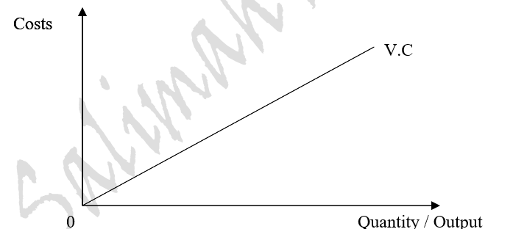
Short Run Costs-
Fixed, Variable and Total Cost

Slide 24
Short Run Costs-
Fixed, Variable and Total Cost
Total cost
The sum of fixed costs and variable costs.
Formula for Total Costs= Fixed Costs + Variable Cost
Total Cost exists with the Fixed Cost and increases with the Variable Cost in the short run. It is also known as the Total Monetary Cost Of Production
output is 0, Total Costs = Fixed Costs

Slide 25
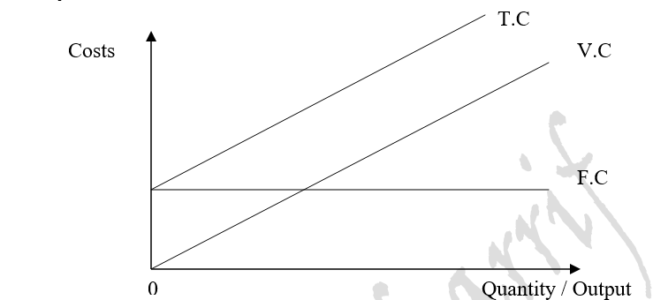
Short Run Costs-
Fixed, Variable and Total Cost

Slide 26
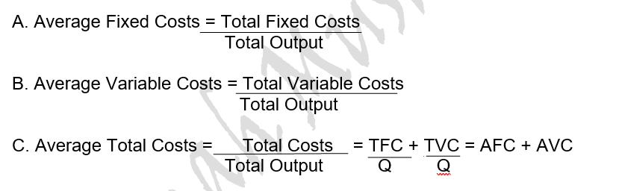
Short Run Costs- Average Costs

Slide 27
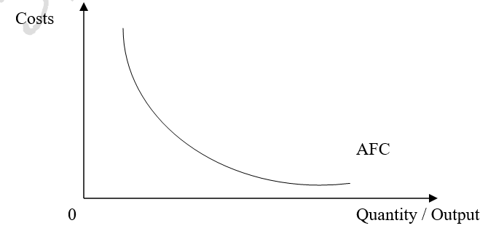
Short Run Costs- Average Costs
Average fixed cost is known as spreading the overhead cost. it is important to remember that it is the only cost in the short run which keeps falling or diminishing as output increases.

Slide 28
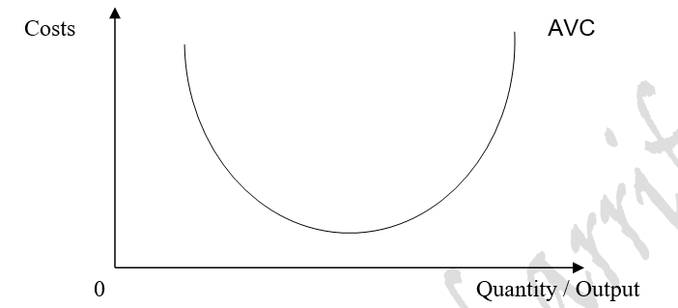
Short Run Costs- Average Costs
Average Variable Costs

Slide 29
Short Run Costs- Average Costs
Average Variable Costs
The shape of this curve is the same as they are a ATC curve. It initially decreases as output increases at an increasing rate, reaches a minimum, and then starts rising when the output increases at a decreasing rate
Since total variable cost reflects the law of diminishing returns, so does AVC. Marginal returns increase initially, fewer additional variable resources are needed to produce output and variable cost per unit declines.
AVC hits a minimum and then rises as diminishing returns require more and more variable resources to produce each additional unit of output.
At very low levels of output production is relatively inefficient and costly because the firm’s fixed plant is understaffed and so average variable cost is relatively high. As output expands, however, greater specialization and better use of the firm’s capital equipment yield more efficiency, and variable cost per unit of output declines. As still more variable resources are added, a point is reached where diminishing returns are incurred. The firm’s capital equipment is now staffed more intensively, and therefore each added input unit does not increase output by as much as preceding inputs. This means that AVC eventually increases.

Slide 30
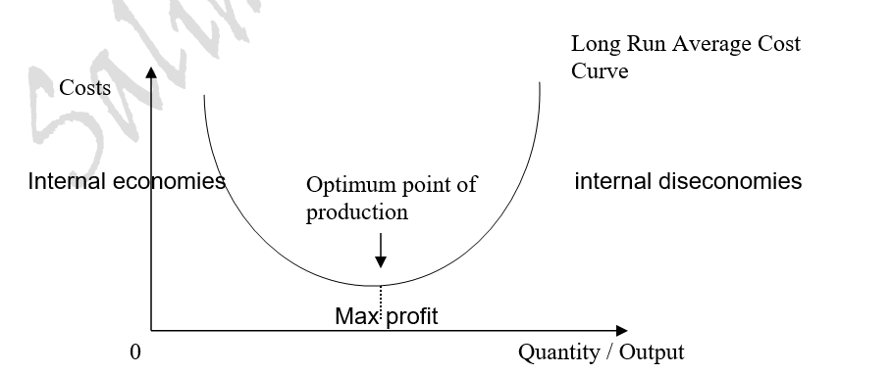
Short Run Costs- Average Costs
Average Total Costs In the short run as input increases, output may get increasing, constant or decreasing returns to scale, while in the long run it results in economies or diseconomies of scale.

Slide 31
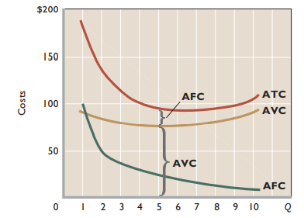
Short Run Costs- Average Costs
ATC can be found by adding vertically the AFC and AVC curves. Vertical distance between the ATC and AVC curves measures AFC at any level of output
Mc Connell & Brue pg. 386

Slide 32
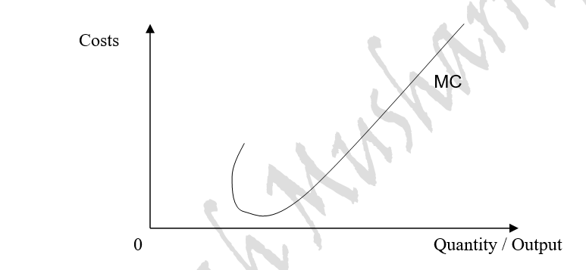
Short Run Costs- Average Costs
Marginal costs It is the cost of the extra unit produced.
MC = New Total Cost – Previous Total Cost
Marginal Cost = ____Change in Total Costs________
Change in number of units produced

Slide 33
Short Run Costs- Average Costs
Marginal Costs
The marginal-cost curve’s shape is a consequence of the law of diminishing returns . If all units of a variable resource (here labor) are hired at the same price, the marginal cost of each extra unit of output will fall as long as the marginal product of each additional worker is rising.
As long as marginal product is rising, marginal cost will fall, the as diminishing returns set in marginal cost begins to rise.
The MC curve is a mirror reflection of the marginal product curve. When marginal product is rising, marginal cost is falling. When marginal product is at its maximum, marginal cost is at its minimum. And when marginal product is falling, marginal cost is rising.

Slide 34
Short Run Costs- Average Costs
Marginal Costs and Marginal Decisions
Marginal costs are costs the firm can control directly and immediately. Specifically, MC designates all the cost incurred in producing the last unit of output. Thus, it also designates the cost that can be “saved” by not producing that last unit. Average-cost figures do not provide this information.
A firm’s decisions as to what output level to produce are marginal decisions, that is, decisions to produce a few more or a few less units. It helps indicate with help of Marginal revenue, if it is profitable to expand or contract its production.

Slide 35
SUMMARY
Economic Costs
Short Run Costs
  Concept of Total, Average and Marginal Products
  Concept of Fixed, Variable and Total Cost
  Average Costs

